Slide 1
Project: Project Documentation and Submission in Fake News Detection Using NLP

Slide 2


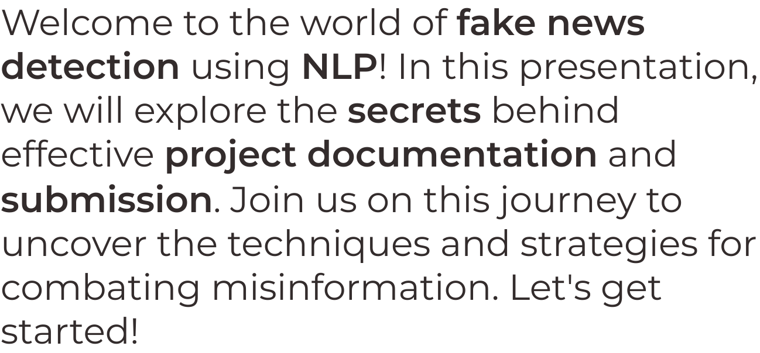
Introduction

Slide 3


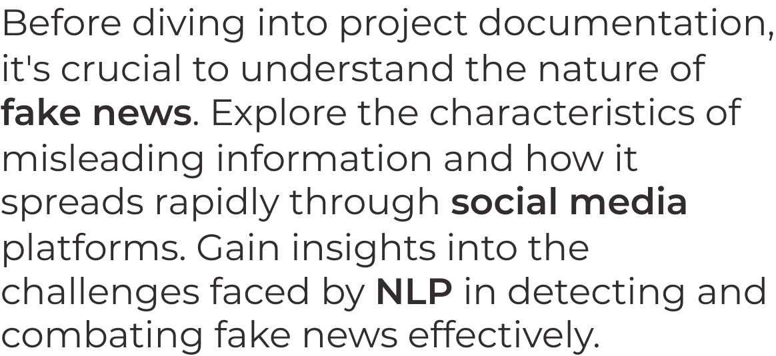
Understanding Fake News

Slide 4

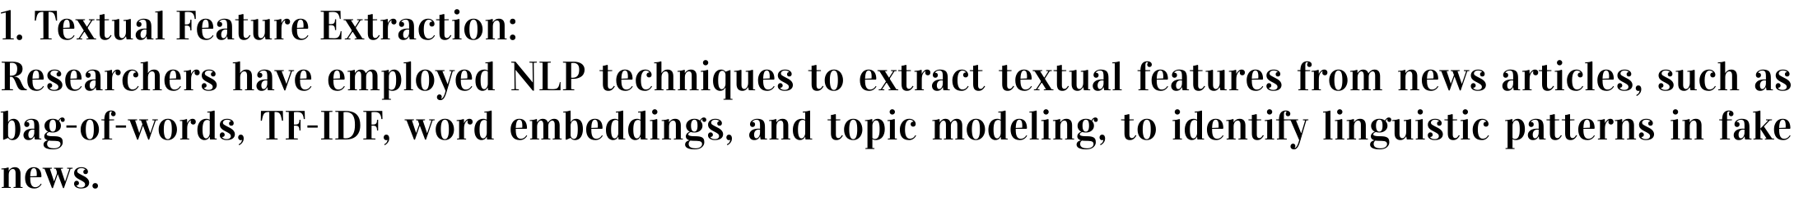

Effective project documentation is the key to success. Learn about the essential components required for documenting a fake news detection project. From problem statement to methodology, we'll guide you through the process of creating comprehensive documentation that showcases your expertise.
Literature review:

Slide 5

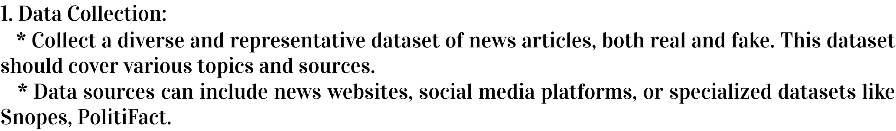

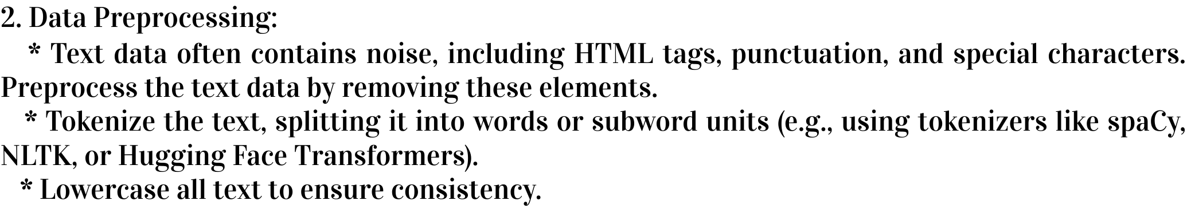
Submitting your project requires attention to detail. Discover the submission guidelines and best practices for presenting your fake news detection project. From formatting requirements to proper organization, we'll provide you with the necessary insights to ensure a successful submission.
Data collection and processing:

Slide 6

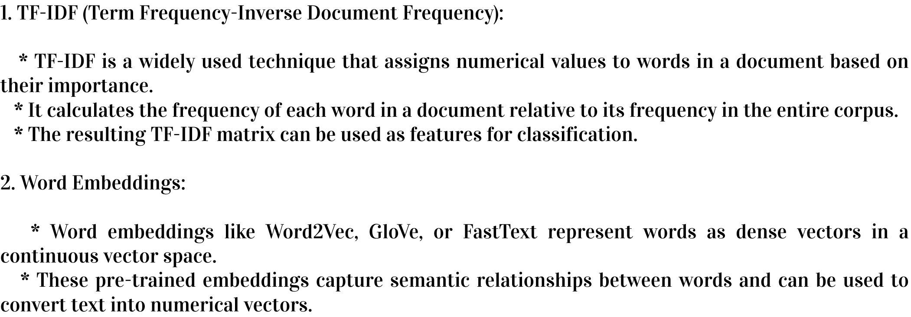
Delve into the world of NLP techniques that empower the detection of fake news. Explore sentiment analysis, topic modeling, and linguistic pattern recognition.
Understand how these techniques can be applied to identify and classify misleading information, enabling effective fake news detection.
Feature extraction:

Slide 7
Modern architecture:

Slide 8

Conclusion
Congratulations! You've uncovered the secrets behind project documentation and submission in fake news detection using NLP. Armed with this knowledge, you're ready to make a significant impact in the fight against misinformation.
Remember, proper documentation and adherence to guidelines are crucial for
success. Stay vigilant and keep debunking fake news!

